Slide 1
ARRAYS

Slide 2
<?php
$Ele = "<html><body><p id='paragraphID'>Hai welcome</p></body></html>";
$d1 = new DOMDocument();
$d1->loadHTML($Ele);
$pValue = $d1->getElementById('paragraphID')->nodeValue;
$pValue=strtoupper($pValue);
echo $pValue;
<?php
$Ele = "<html><body><p>one</p><p>two</p></body></html>";
$d1 = new DOMDocument();
$d1->loadHTML($Ele);
$pTags = $d1->getElementsByTagName('p');
foreach ($pTags as $p) {
echo $p->nodeValue, PHP_EOL;
}

Slide 3
Regular expression
preg_match() | Returns 1 if the pattern was found in the string and 0 if not
preg_match_all() | Returns the number of times the pattern was found in the string, which may also be 0
preg_replace() | Returns a new string where matched patterns have been replaced with another string
Expression | Description
[abc] | Find one character from the options between the brackets
[^abc] | Find any character NOT between the brackets
[0-9] | Find one character from the range 0 to 9

Slide 4
<!DOCTYPE html>
<html>
<body>
<?php
$str = "Visit 342342Schools";
$pattern = "/[0-9]/";
echo preg_match_all($pattern, $str);
?>
</body>
</html>
<?php
$string = 'This is24dwcwdc welcome 345</b>';
$pattern = '/[aeiou]/';
$replacement = '<b>$0</b>';
echo preg_replace($pattern , $replacement , $string);
?>
<?php$pattern = '/\b\d{3}+\b/'; // Regular expression to match digits
$text = "123 456 7890"; // Example text with multiplenumbers
$n=preg_match_all($pattern, $text, $matches);
for ($i=0;$i<$n;$i++)
echo $matches[0][$i],"\n";
?>

Slide 5
An array in PHP is actually an ordered map. A map is a type that associates values to keys.
This type is optimized for several different uses; it can be treated as an array, list (vector), hash table (an implementation of a map), dictionary, collection, stack, queue, and probably more.
As array values can be other arrays, trees and multidimensional arrays are also possible.

Slide 6
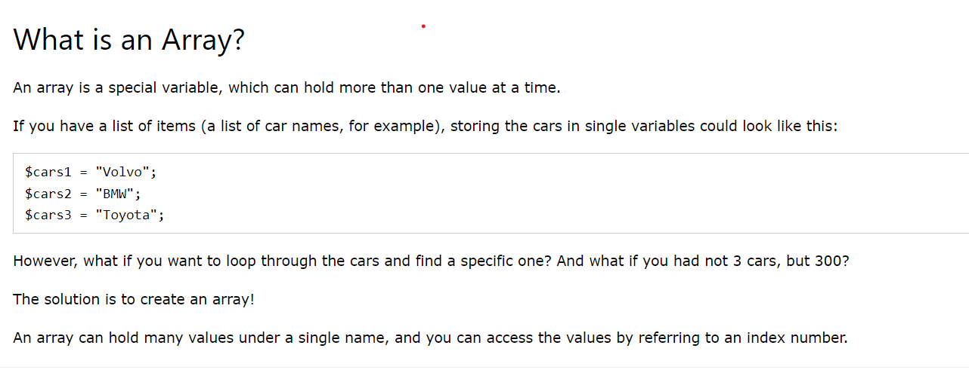
An array stores multiple values in one single variable:

Slide 7
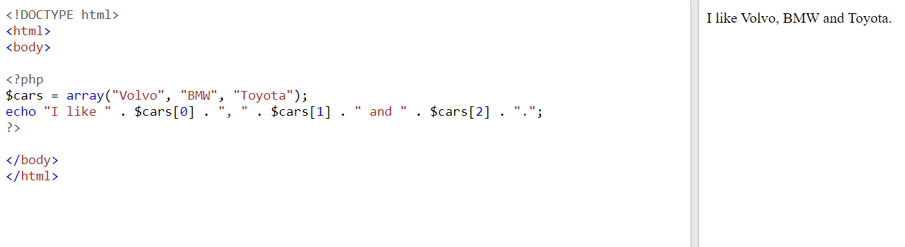

Slide 8
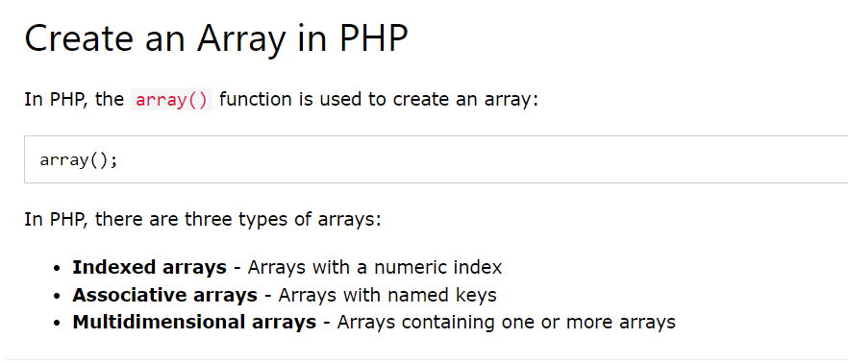

Slide 9
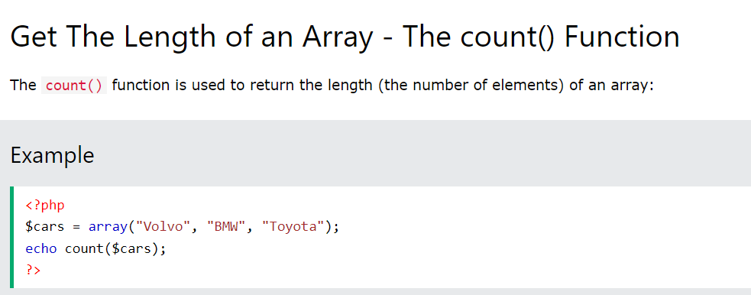

Slide 10
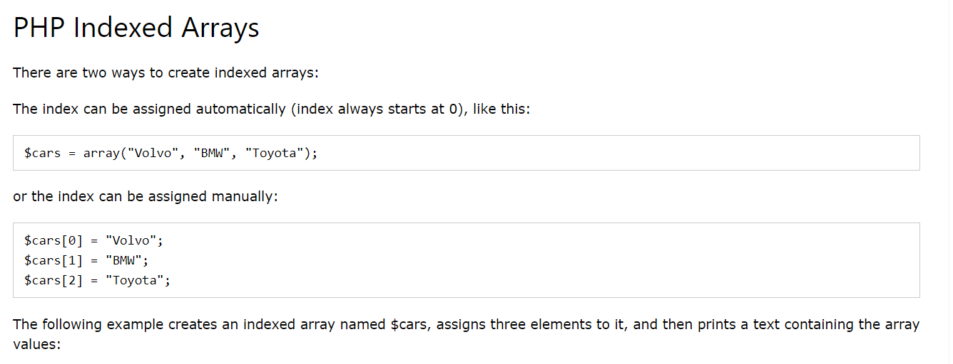

Slide 11
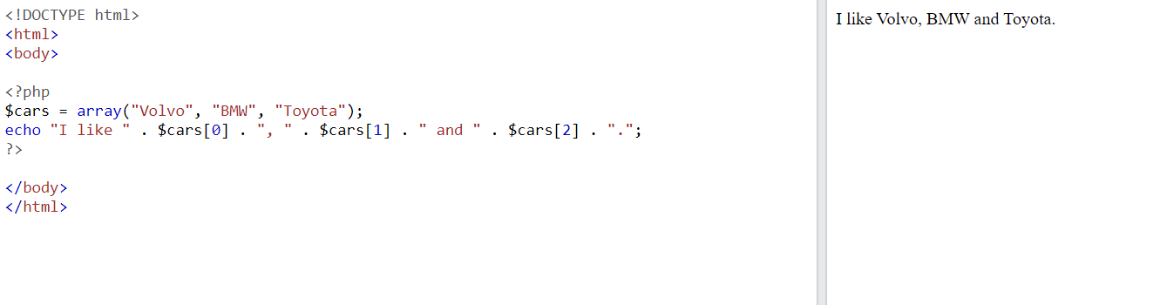

Slide 12
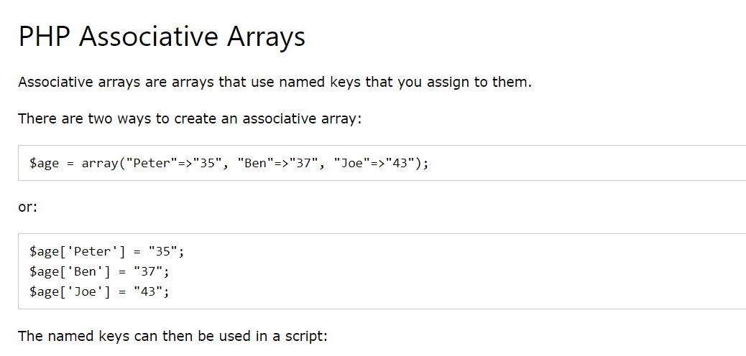
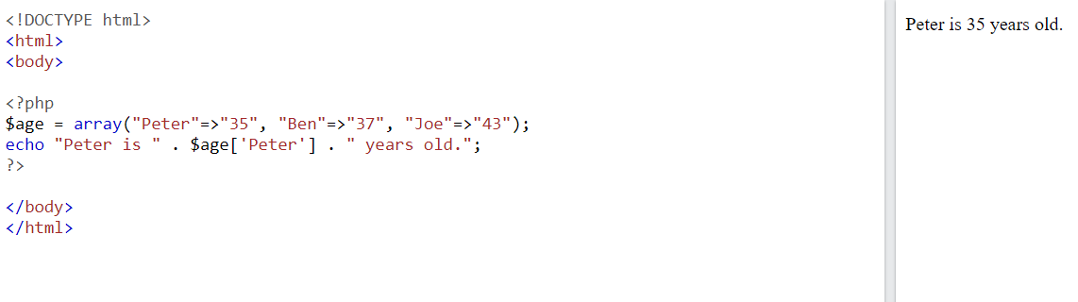

Slide 13
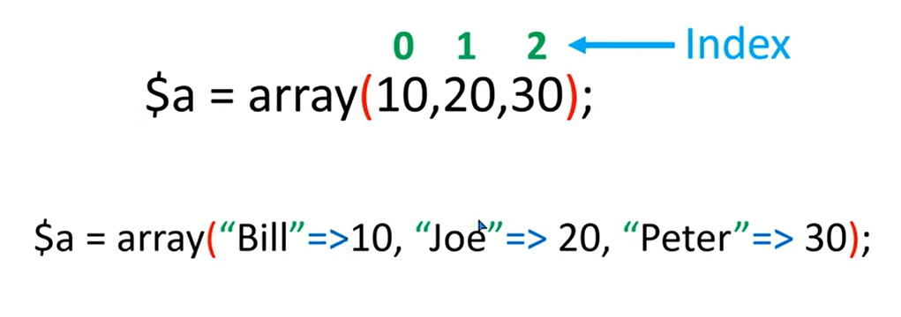
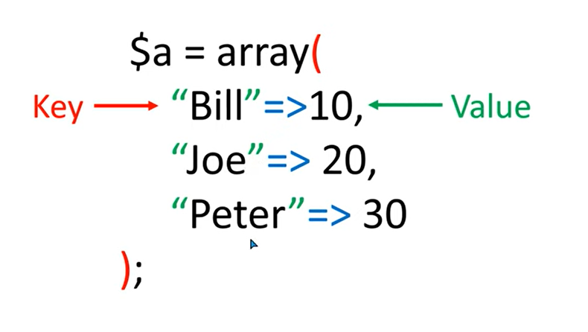
Associative Array

Slide 14
Strings containing valid decimal ints, unless the number is preceded by a + sign, will be cast to the int type. E.g. the key "8" will actually be stored under 8. On the other hand "08" will not be cast, as it isn't a valid decimal integer.
Floats are also cast to ints, which means that the fractional part will be truncated. E.g. the key 8.7 will actually be stored under 8.
Bools are cast to ints, too, i.e. the key true will actually be stored under 1 and the key false under 0.
Null will be cast to the empty string, i.e. the key null will actually be stored under "".
Arrays and objects can not be used as keys. Doing so will result in a warning: Illegal offset type.
<?php $array = array( 1 => "a", "1" => "b", 1.5 => "c", true => "d", ); var_dump($array); ?>
<?php
$array = array(
"foo" => "bar",
"bar" => "foo",
+100 => -100,
-10 => 100,
);
var_dump($array);
echo "$array[100]";
?>
<?php
$array = array(
12 => "a",
"hai" => "b",
2.5 => "c",
true => "d",
);
var_dump($array);
?>

Slide 15
Loop Through an Associative Array
To loop through and print all the values of an associative array, you could use a foreach loop, like this:
<?php $age = array("Peter"=>"35", "Ben"=>"37", "Joe"=>"43"); foreach($age as $x => $x_value) { echo "Key=" . $x . ", Value=" . $x_value; echo "<br>"; } ?>
Key=Peter, Value=35 Key=Ben, Value=37 Key=Joe, Value=43

Slide 16
TRY THIS
Creating an Associative Array: Create an associative array with student names as keys and their corresponding scores as values. Then, display the array.
Accessing Values: Write a program to access and print specific values from an associative array, such as the score of a particular student.
Searching for a Key: Write a script to search for a specific key in an associative array (e.g., searching for a student by maximum mark and print name).
4.Counting and Summing Values: Calculate the total score of all students in an associative array and find the average score.

Slide 17
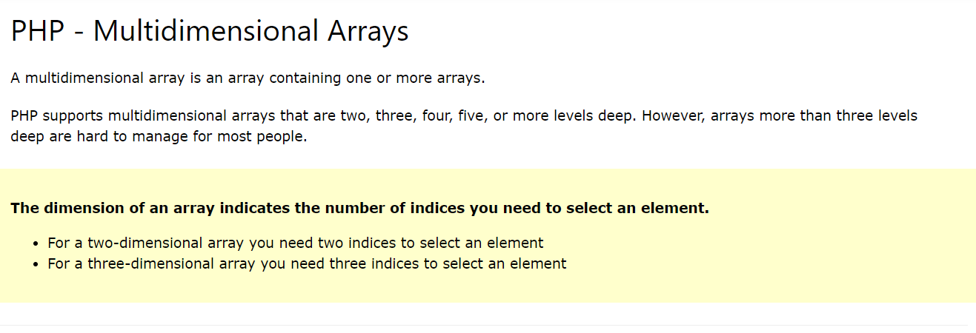

Slide 18
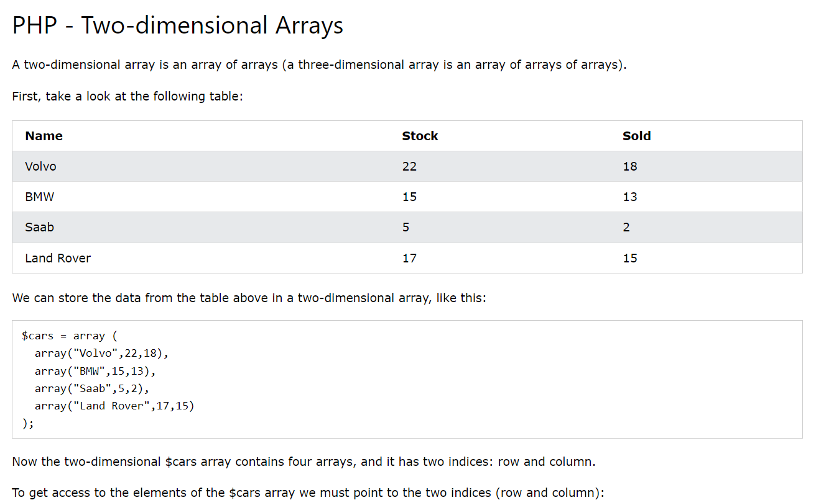

Slide 19
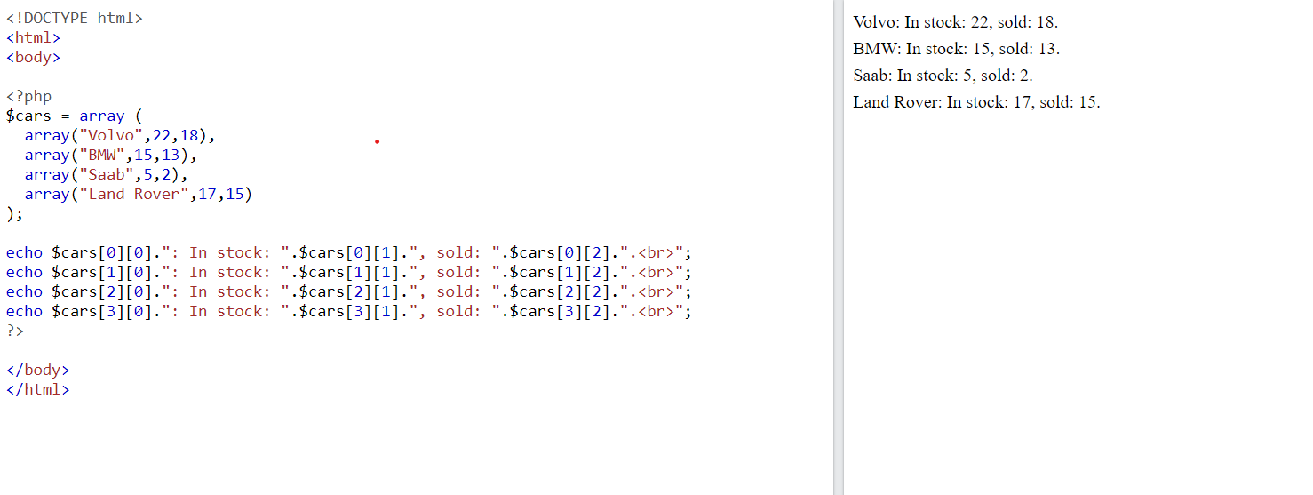

Slide 20
<?php $array = array( "foo" => "bar", 42 => 24, "multi" => array("dimensional" => array("array" => "foo") ) ); var_dump($array["foo"]); var_dump($array[42]); var_dump($array["multi"]["dimensional"]["array"]); ?>
string(3) "bar"
int(24)
string(3) "foo"

Slide 21
// Access and print information for a specific student
$studentID = "student2";
echo "Student ID: $studentID<br>";
echo "Name: " . $students[$studentID]["name"] . "<br>";
echo "Age: " . $students[$studentID]["age"] . "<br>";
echo "Grade: " . $students[$studentID]["grade"] . "<br>";
// You can also loop through all students and display their information
foreach ($students as $studentID => $studentInfo) {
echo "Student ID: $studentID<br>";
echo "Name: " . $studentInfo["name"] . "<br>";
echo "Age: " . $studentInfo["age"] . "<br>";
echo "Grade: " . $studentInfo["grade"] . "<br>";
echo "<br>"; // Add a newline for separation
}
?>
<?php
// Create an associative array to store student information
$students = array(
"student1" => array(
"name" => "John Smith",
"age" => 20,
"grade" => "A"
),
"student2" => array(
"name" => "Jane Doe",
"age" => 21,
"grade" => "B"
),
"student3" => array(
"name" => "Michael Johnson",
"age" => 19,
"grade" => "C"
)
);

Slide 22
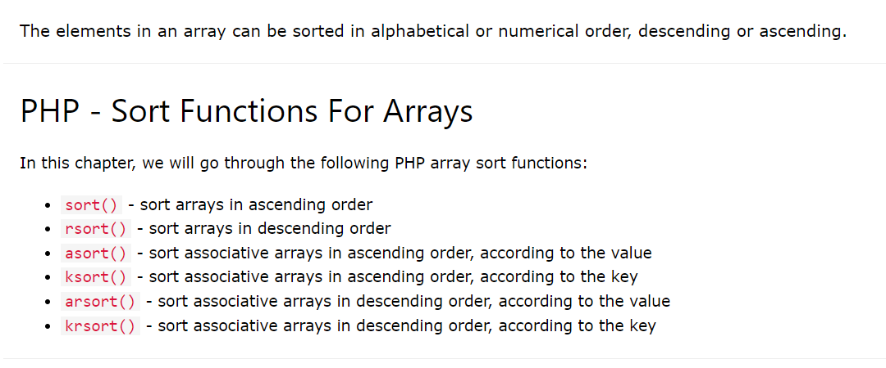

Slide 23
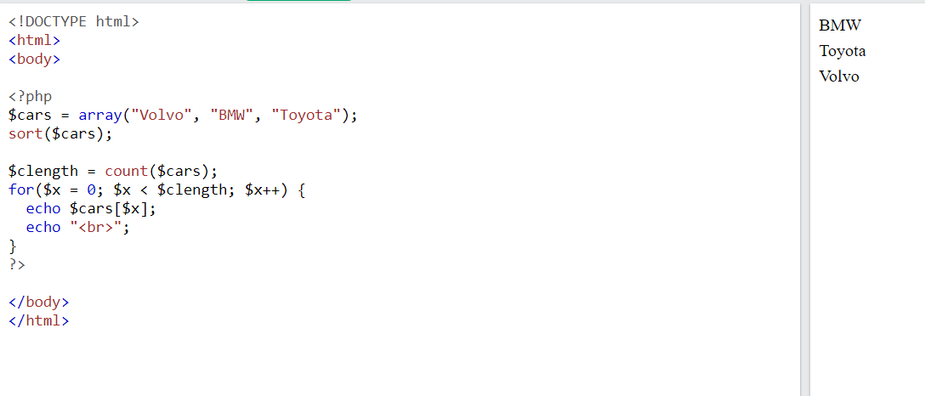
Sort Array in Ascending Order - sort()
The following example sorts the elements of the $cars array in ascending alphabetical order:

Slide 24
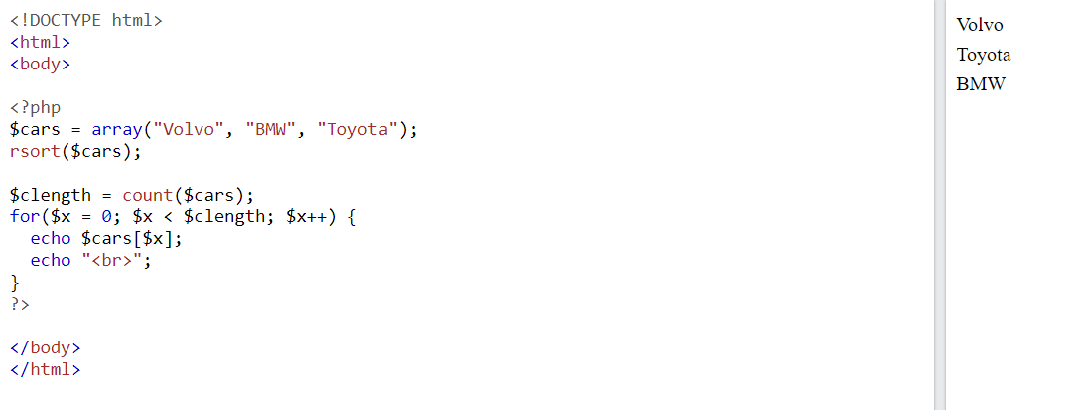
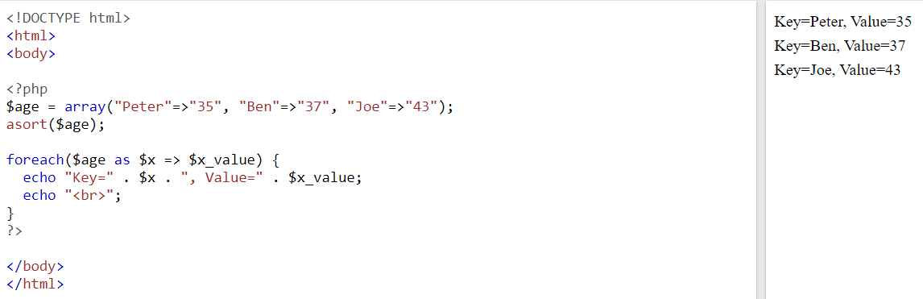
Sort Array in Descending Order - rsort()
Sort Array (Ascending Order), According to Value - asort()

Slide 25
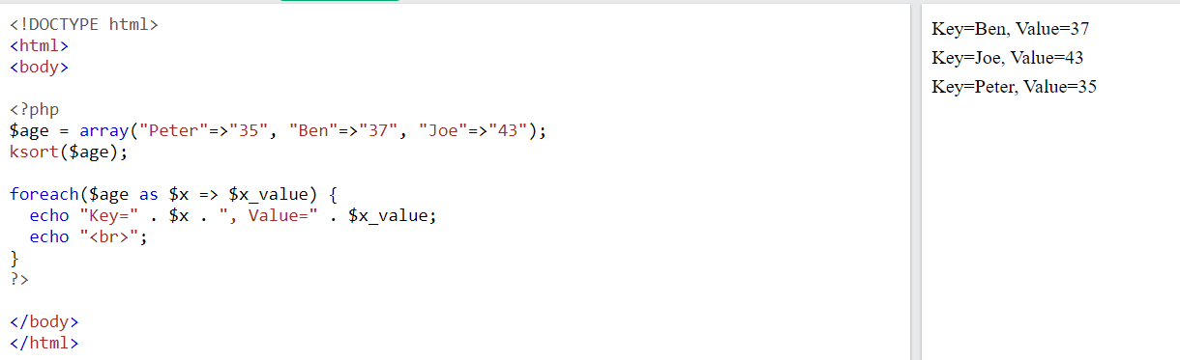
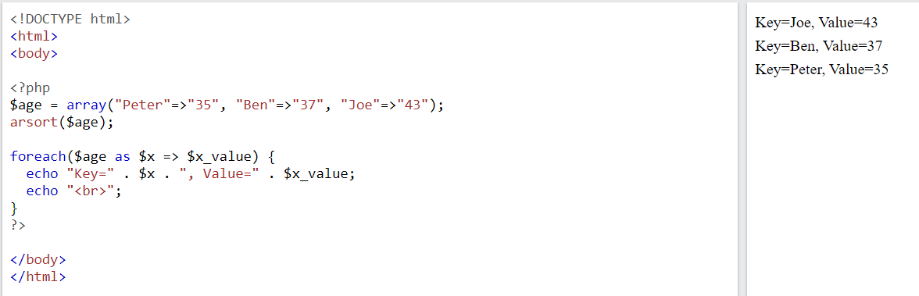
Sort Array (Ascending Order), According to Key - ksort()
Sort Array (Descending Order), According to Value - arsort()

Slide 26
Array Opeartions
count():
The count() function returns the number of elements in a given array.
Syntax :
count(array_name,mode_of_count); // mode is either 0 or 1
<?php
$array = ['One', 'Two', 'Three',array(1,2,3)];
echo count($array,0);
?>

Slide 27
<?php
$array = [10,20,30];
echo array_sum($array);
?>
array_sum():
The array_sum() function returns the sum of all the values in a given array.
Syntax:array_sum(array_name);
<?php
$a=array("a"=>52.2,"b"=>13.7,"c"=>0.9);
echo array_sum($a);
?>
array_reverse():
The array_reverse() function is used to return an array in the reverse order.
Syntax:array_reverse(array);
<?php
$cities=array("D"=>"Delhi","M"=>"Mumbai","N"=>"Nagpur");
$rev=array_reverse($cities);
print_r($rev);
?>
<?php
$cities=array(10,67,98,34);
$rev=array_reverse($cities);
print_r($rev);
?>

Slide 28
shuffle():
The shuffle() function randomizes the order of elements in the array.
After shuffling it assigns new keys to the elements in the array. It returns true on success and false on failure.
Syntax:shuffle(array);
<?php
$cities=array("D"=>"Delhi","M"=>"Mumbai","N"=>"Nagpur");
print_r($cities);
shuffle($cities);
print_r($cities);
?>

Slide 29
current():
The current() function returns the value of a current element in an array.
There is an internal pointer in an array which points to every element in an array. By default it always points to the first element i.e. the zeroth element of the array.
It returns false if the array is empty.
Syntax:current(array);
It takes the array whose current element value is to be known as the parameter.
end():
The end() function moves the internal pointer to the last element of the array and returns the last element value of the array.
Syntax:end(array);
It takes the array as the parameter whose last element value is to be known.
next();
The next() function moves the internal pointer to the next element and returns its value.
Syntax:next(array);
It takes the array as the parameter whose next element value is to be known.
prev():
The prev() function moves the internal pointer to the previous element and returns its value.
Syntax:prev(array);
It takes the array as the parameter whose previous element value is to be known.
reset():
The reset() function moves the internal pointer to the first element of the array and returns it value.
Syntax:reset(array);
It takes the array as the parameter whose internal pointer is to be set at the first element

Slide 30
<?php
//demonstration of current function.
$players=array("Shilpa","Monica","Shruti","Pranav","Rakesh");
echo "Array elements are: ";
foreach($players as $p)
echo $p."&nbsp;&nbsp;";
echo "<br><br>7)reset():".reset($players)."<br>";
echo "8)next():".next($players)."<br>";
echo "9)end():".end($players)."<br>";
echo "10)prev():".prev($players)."<br>";
echo "11)current():".current($players)."<br>";
?>
Array elements are: Shilpa Monica Shruti Pranav Rakesh 7)reset():Shilpa 8)next():Monica 9)end():Rakesh 10)prev():Pranav 11)current():Pranav

Slide 31
array_unique():
The array_unique() function is used to remove duplicate values from an aray.
If there are more than one similar values in a given array then, the array_unique() function keeps the first occurance of the duplicate values and removes the rest of the values.
It keeps the key of the first occurrence of the value.
Syntax:array_unique(array);
It takes the array whose ambiguous elements are to be removed.
array_merge():
The array_merge() function is used to merge one or more arrays into one.
Syntax:array_merge(array1, array2, array3,….);

Slide 32
<?php
//demonstration of array_unique function.
echo "13) array_unique():<br>";
$no=array(10,56,20,10,45,30,45);
echo "original array:<br>";
foreach($no as $m)
echo "<strong>".$m."&nbsp;&nbsp;</strong>";
$no1=array_unique($no);
echo "<br>unique array:<br>";
foreach($no1 as $m)
echo "<strong>".$m."&nbsp;&nbsp;</strong>";
//demonstration of array_merge function.
echo "<br><br>14) array_merge():<br>";
$fruits=array("A"=>"Apple","M"=>"Mango","O"=>"Orange");
$flowers=array("R"=>"Rose","M"=>"Mogra","H"=>"Hibiscus");
echo "original fruits array:<br>";
foreach($fruits as $f)
echo "<strong>".$f."&nbsp;&nbsp;</strong>";
echo "<br>original flowers array:<br>";
foreach($flowers as $f)
echo "<strong>".$f."&nbsp;&nbsp;</strong>";
$res=array_merge($fruits,$flowers);
echo "<br>resultant array:<br>";
foreach($res as $f)
echo "<strong>".$f."&nbsp;&nbsp;</strong>";
?>
13) array_unique(): original array: 10 56 20 10 45 30 45 unique array: 10 56 20 45 30 14) array_merge(): original fruits array: Apple Mango Orange original flowers array: Rose Mogra Hibiscus resultant array: Apple Mogra Orange Rose Hibiscus

Slide 33
array_pop():
The array_pop() function deletes the last element from the array.
Syntax:array_pop(array);
It takes array as a parameter whose last element is to be deleted.
It returns the last value from the array otherwise it returns NULL if the array is empty.
array_push():
The array_push() function adds one or more values at the end of the array.
Syntax:array_push(array,value1,value2,….);
Array
(
[0] => 10
[1] => 56
[2] => 20
[3] => 10
[4] => 45
[5] => 30
)
Array
(
[0] => 10
[1] => 56
[2] => 20
[3] => 10
[4] => 45
[5] => 30
[6] => 100
[7] => 200
)
<?php $no=array(10,56,20,10,45,30,45);
array_pop($no);
print_r($no);
array_push($no,100,200);
print_r($no);
?>

Slide 34
Traversing Arrays
The most common task with arrays is to do something with every element
foreach Construct The most common way to loop over elements of an array is to use the foreach construct:
The Iterator Functions Every PHP array keeps track of the current element you're working with; the pointer to the current element is known as the iterator docstore.(next,prev,current,end,…)
<?php
$no=array(10,56,20,10,45,30,45);
foreach($no as $i)
echo $i." ";?>

Slide 35
Using a for Loop
If you know that you are dealing with an indexed array, where the keys are consecutive integers beginning at 0, you can use a for loop to count through the indexes. T
he for loop operates on the array itself, not on a copy of the array, and processes elements in key order regardless of their internal order.
<?php
$no=array(10,56,20,10,45,30,45);
for($i=0;$i<count($no);$i++)
{
echo $no[$i]." ";
}
?>

Slide 36
Calling a Function for Each Array Element
PHP provides a mechanism, array_walk( ), for calling a user-defined function once per element in an array:
array_walk(array, function_name);
<?php
function print_row($value, $key)
{
print("$key $value\n");
}
$person = array('name' => 'Fred', 'age' => 35, 'wife' => 'Wilma');
array_walk($person, 'print_row');
?>
name Fred age 35 wife Wilma
in_array() Function
<?php
$array = [1,5,6,7,8,9,5,434,23,98];
if (in_array(8, $array))
echo 'Yes';
else
echo 'No';
?>
If you want to check if an element exists in the array, it's the in_array()
function which comes to the rescue.

Slide 37
Few functions
is_array()
This is one of the most useful functions for dealing with arrays. It's used to check if a variable is an array or some other data type.
<?php
$array = ['One', 'Two', 'Three'];
if (is_array($array))
{
// perform some array operation
}
?>
Array
(
[0] => One
[1] => Two
[2] => Three
)
<?php
$string = "One Two Three";
$array = explode(" ", $string);
print_r($array);
?>
explode() Function
The explode() function splits a string into multiple parts and returns it as an array. For example, let's say you have a comma-separated string and you want to split it at the commas.

Slide 38
implode() Function
This is the opposite of the explode() function—given an array and a glue string, the implode() function can generate a string by joining all the elements of an array with a glue string between them.
<?php
$array = ['One', 'Two', 'Three'];
$string = implode(",", $array);
echo $string;
?>
One,Two,Three
array_slice() Function
The array_slice() function is useful when you want to extract some portion of a given array
<?php
$people = [1,5,6,7,8,9,5,3,4];
$members = array_slice($people, 2, 4);
print_r($members);
?>
Array
(
[0] => 6
[1] => 7
[2] => 8
[3] => 9
)

Slide 39
array_splice() Function
Th array_splice() function is useful when you want to get rid of a portion of an array and/or replace it with something else. It also accepts four parameters: the array, the offset index from which to begin the removal, the length t
<?php
$all_items = ["Charger", "Keyboard", "Smartphone", "Baseball", "Bat", "Mouse"];
$replacements = ["Pen", "Headphones"];
array_splice($all_items, 2, 4, $replacements);
print_r($all_items);
?>
Array
(
[0] => Charger
[1] => Keyboard
[2] => Pen
[3] => Headphones
)

Slide 40
<!DOCTYPE html>
<html>
<body>
<?php
$data=[
["id"=>1,"name"=>"maksud","mobile"=>"0187","address"=>"chandpur"],
["id"=>2,"name"=>"tonmoy","mobile"=>"0177","address"=>"dhaka"],
["id"=>3,"name"=>"abir","mobile"=>"0155","address"=>"khulna"]];
echo "<table border=3><tbody>";
foreach(["id","name","mobile"] as $attribute) {
echo "<tr><td>".$attribute."</td>";
foreach($data as $row) {
echo "<td>".$row[$attribute]."</td>";
}
echo "</tr>";
}
echo "</tbody></table>";
?>
</body>
</html>

Slide 41
String
PHP string is a sequence of characters i.e., used to store and manipulate text. PHP supports only 256-character set and so that it does not offer native Unicode support. There are 4 ways to specify a string literal in PHP.
single quoted
double quoted
heredoc syntax
newdoc syntax (since PHP 5.3)

Slide 42
Single quote
The simplest way to specify a string is to enclose it in single quotes (the character ').
To specify a literal single quote, escape it with a backslash (\).
To specify a literal backslash, double it (\\).
All other instances of backslash will be treated as a literal backslash: this means that the other escape sequences you might be used to, such as \r or \n, will be output literally as specified rather than having any special meaning.
<?php
$a="hai";
echo 'This will not expand: \n a newline $a';
?>
This will not expand: \n a newline $a

Slide 43
Double Quoted
In PHP, we can specify string through enclosing text within double quote also. But escape sequences and variables will be interpreted using double quote PHP strings.
Heredoc <<<
Nowdoc
<?php
$a="hai";
echo "This will not expand: \t a newline $a";
?>
<?php
echo <<<END
a \n
b
c
END;
?>
a
b
c
Strings is the heredoc syntax: <<<. After this operator, an identifier is provided, then a newline. The string itself follows, and then the same identifier again to close the quotation.
<?php
echo <<<'END'
a \n
b
c
END;
?>
a \n
b
c
.A nowdoc is specified similarly to a heredoc, but no parsing is done inside a nowdoc.
A nowdoc is identified with the same <<< sequence used for heredocs, but the identifier which follows
is enclosed in single quotes,

Slide 44
String Functions
strlen() function:
strrev() function:
substr_replace( $string, $replacement, $start, $length)
strtolower() function
strtoupper() function
ucfirst() function
lcfirst() function
ucwords()
Str_word_count(String)
Strops(String,text);
Str_replace(string to be replaced,text,string)

